Slide 1
Physics Unit 1 – Measuring Movements
Grade 7

Slide 2
What is Measurement?
Measurement is how we find out how much, how long, or how heavy something is—by comparing it to a known standard (like a meter, kilogram, or second).
Key Concept
Change
Related Concepts
Patterns
Predictions
Global Context
Scientific and technical innovation
Exploration:
systems, models, methods
Statement of Inquiry: Studying patterns helps us to predict the changes in the world around us.
Notes:
Feedback form: https://forms.office.com/r/N0gcXwDT3K

Slide 3
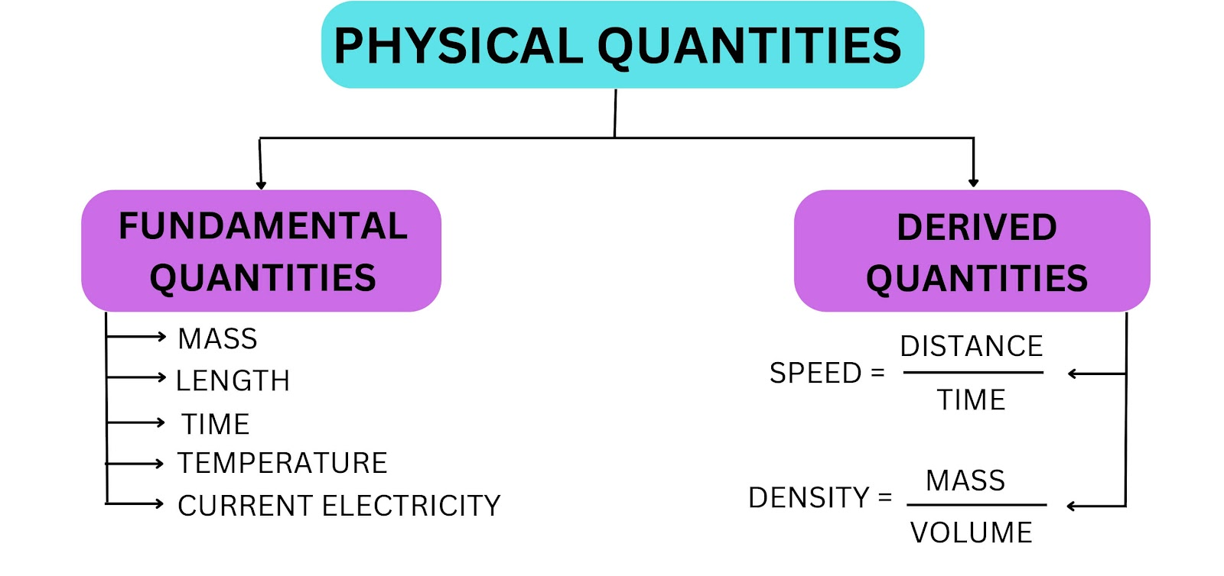
A Physical Quantity is a quantity which can be measured.
Eg: Length of a string, Height of a building, Time taken to do an activity, Mass of an object, Speed of a vehicle
Non- examples: Happiness, admiration, tiredness

Slide 4
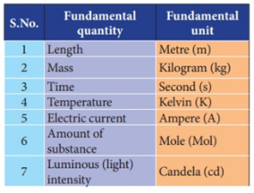
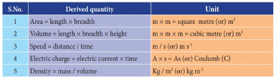

Slide 5
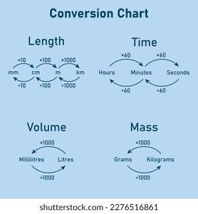

Slide 6
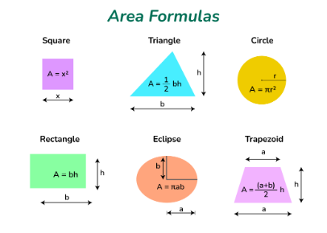
Notes:
https://byjus.com/maths/area-of-irregular-shapes/

Slide 7
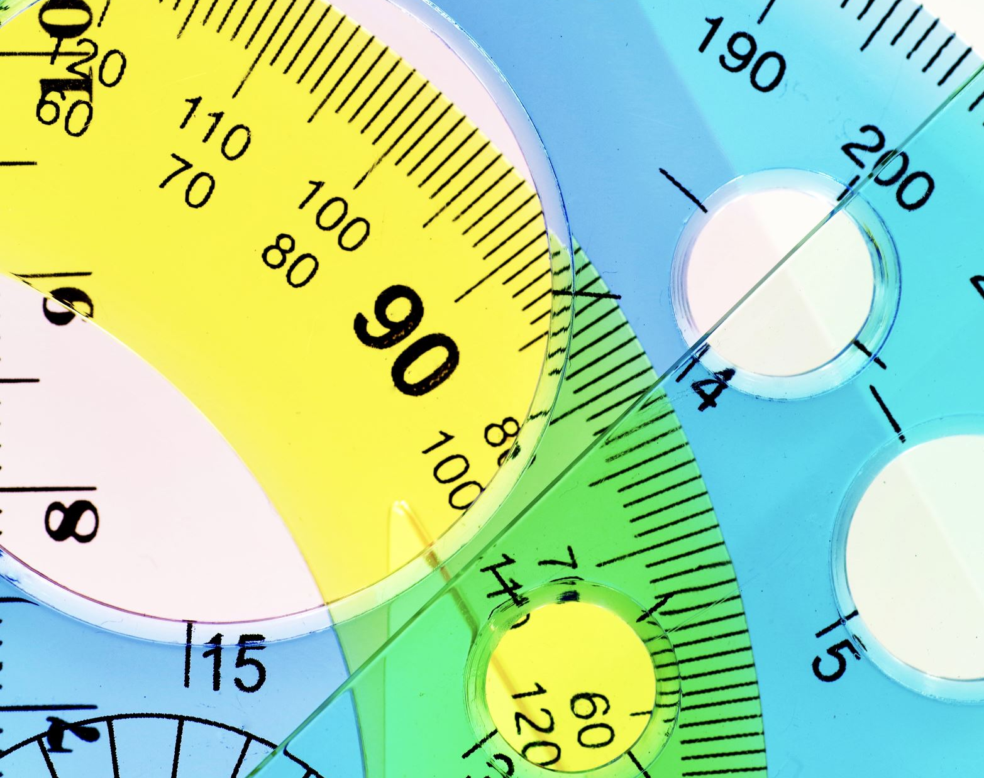
Accuracy, Precision and Significant Figures - Recap from Grade 6

Slide 8
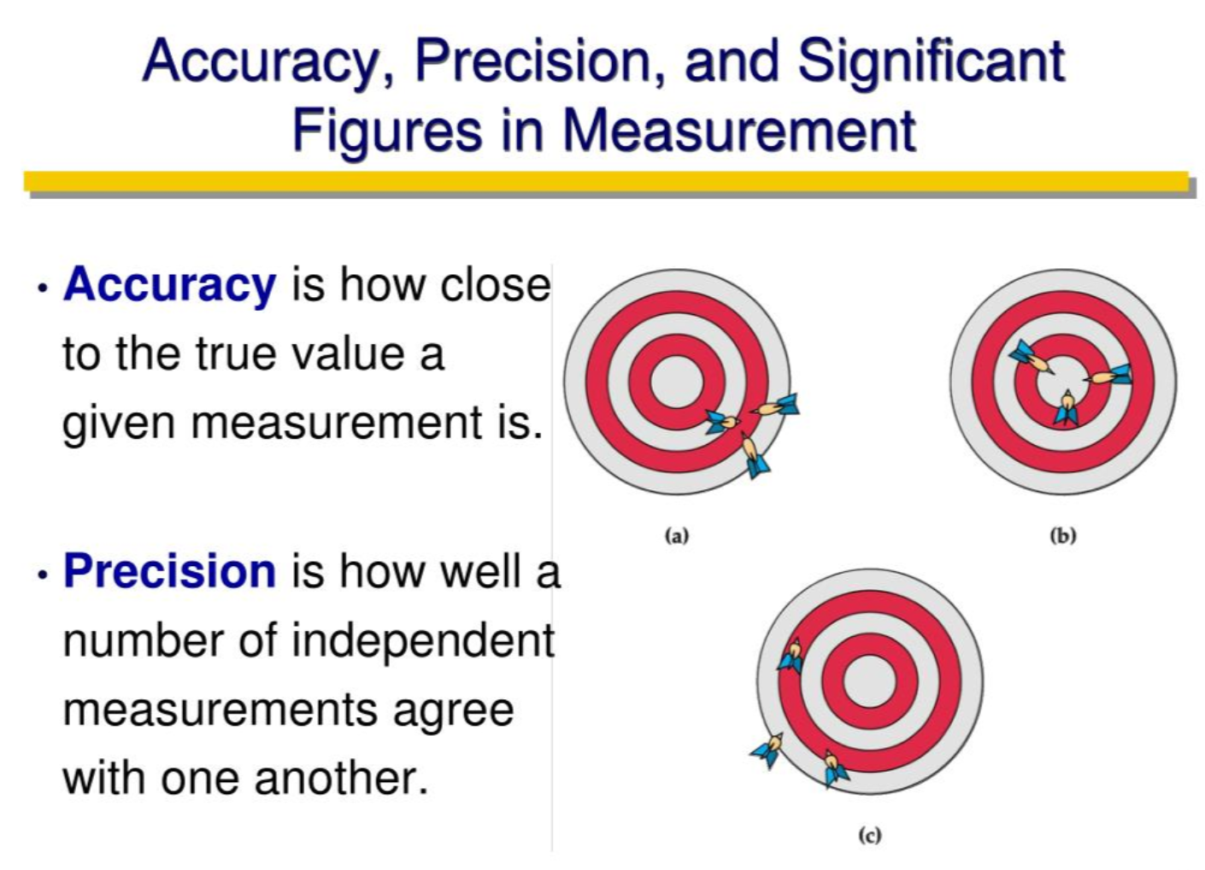

Slide 9
Least Count
Least Count is the smallest length, mass, time, or volume that a measuring tool can read accurately.
Eg: If a ruler has markings for every 1 mm, then: Least count = 1 mm This means the ruler can measure lengths as small as 1 mm.
Ask: Can this ruler measure something that is 0.25 mm long? No — that's smaller than the least count!
Eg: Measuring Cylinder:
If the smallest graduation is 2 mL: Least count = 2 mL If the water level is between 24 and 26 mL, you can't say it's 25.2 mL with confidence.
Tip: Always record values up to the least count — don’t guess beyond it!
Eg: Weighing Scale (Digital)
If a kitchen scale shows mass like 125.0 g, 125.5 g, 126.0 g — Least count = 0.5 g So, you shouldn’t write 125.36 g unless the scale can show that.
Why Does Least Count Matter?
It tells us how precise our measurements are.
It prevents us from recording values we can’t actually see.
If two students use instruments with different least counts, one will get more precise results.

Slide 10
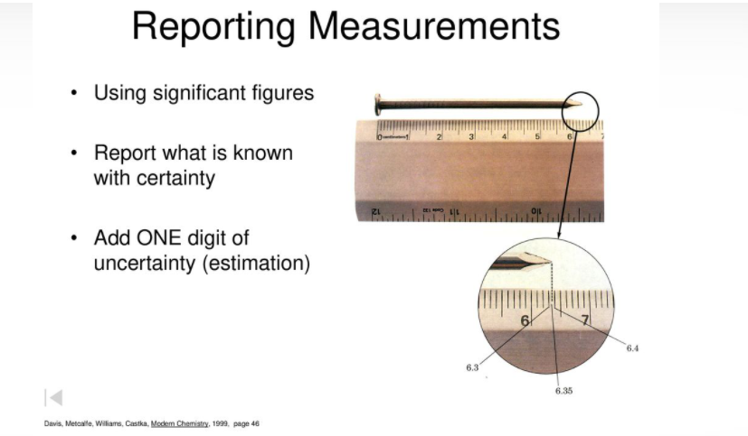

Slide 11
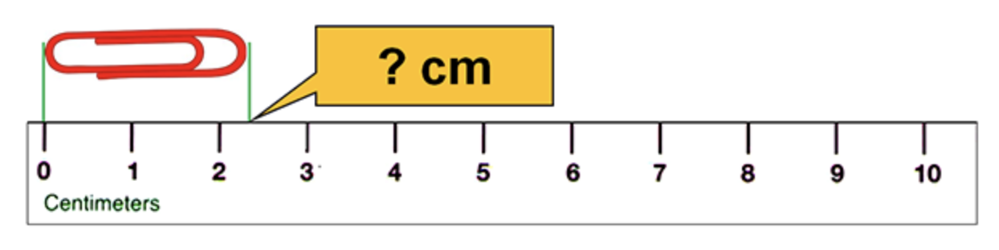
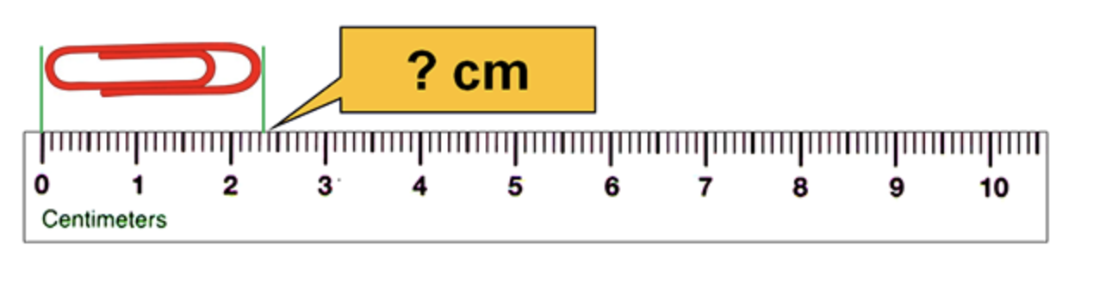
Which scale would you choose to measure the length of the paper clip and why?
1
2

Slide 12
1
This ruler, is marked every one centimeter so we know the ones place and could record the length of the paper clip as 2 cm. However, we can obviously see that that is not the accurate or precise reading!
2
In this case, the ruler is marked in both ones and tenths meaning that we can clearly see the first part of the measurement is 2.3 cm. This reading can be considered more precise and accurate!
Significant digits (also called significant figures or “sig figs” for short) indicate the precision of a measurement. A number with more significant digits is more precise. For example, 8.1 cm is more precise than 8 cm. It’s sometimes easier to think of this in terms of recording all of the known “places” (ones, tenths, hundredths) plus a final estimated place.

Slide 13
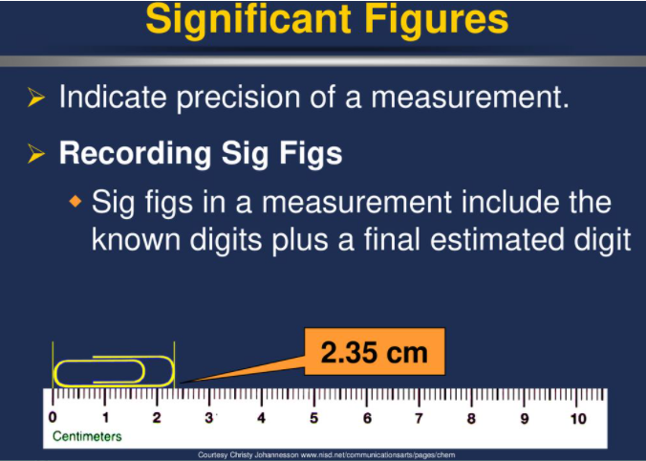

Slide 14
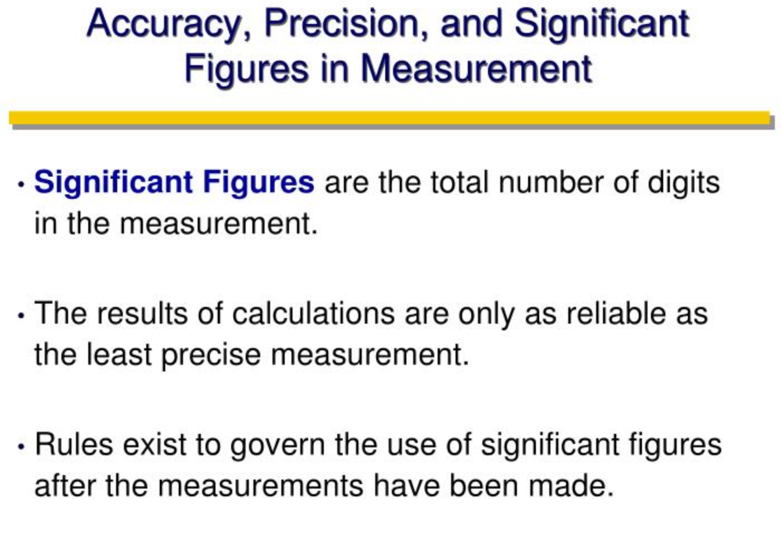

Slide 15
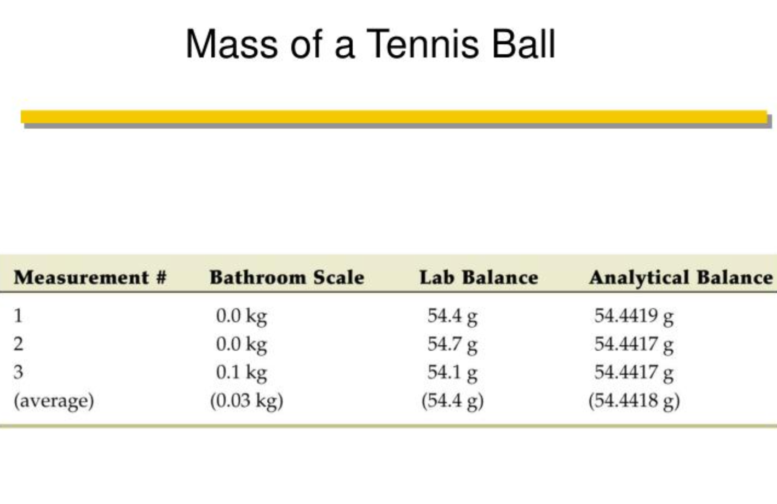

Slide 16
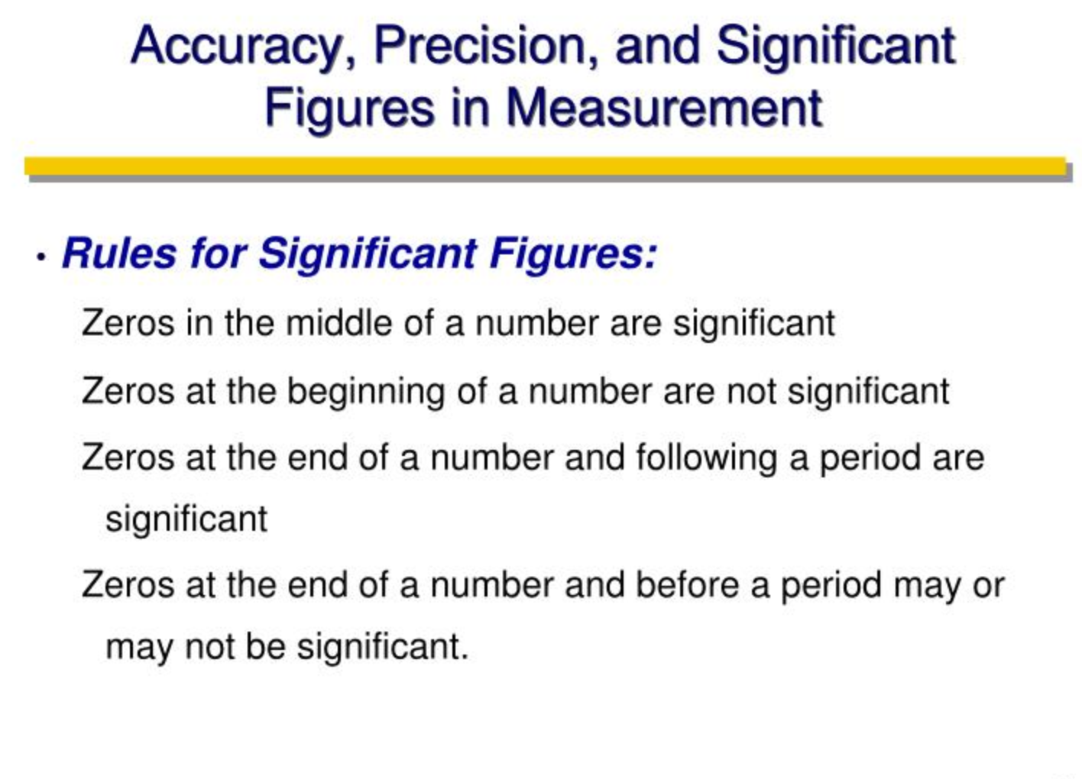

Slide 17
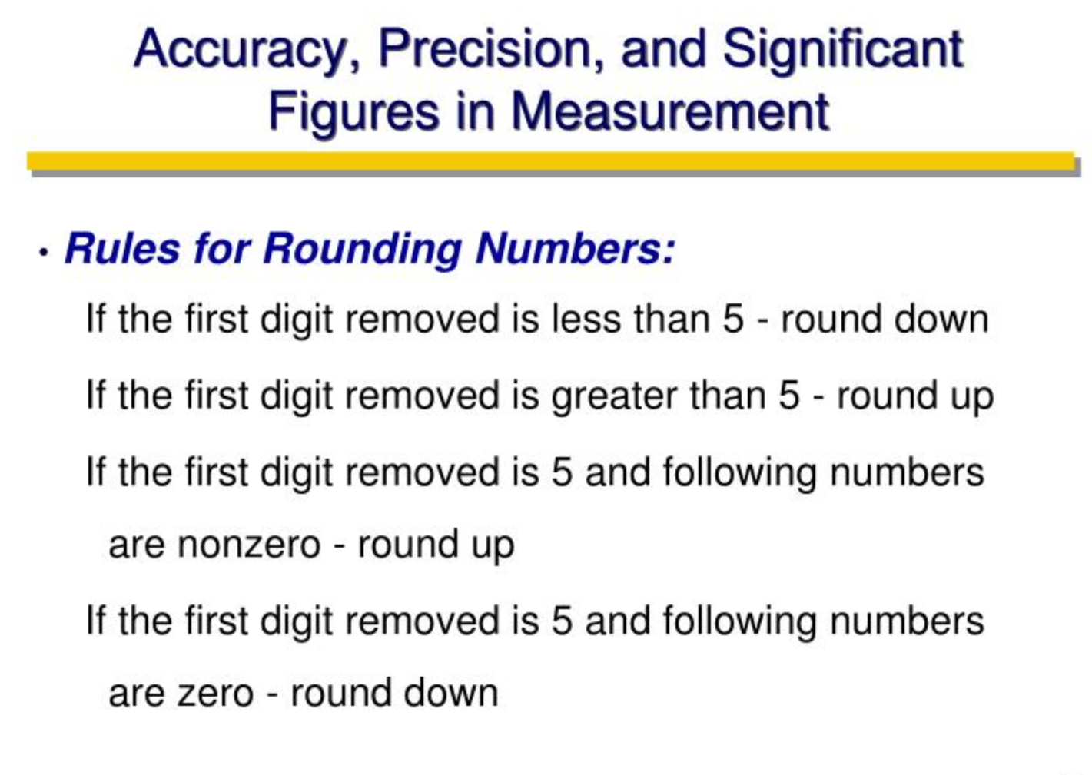

Slide 18
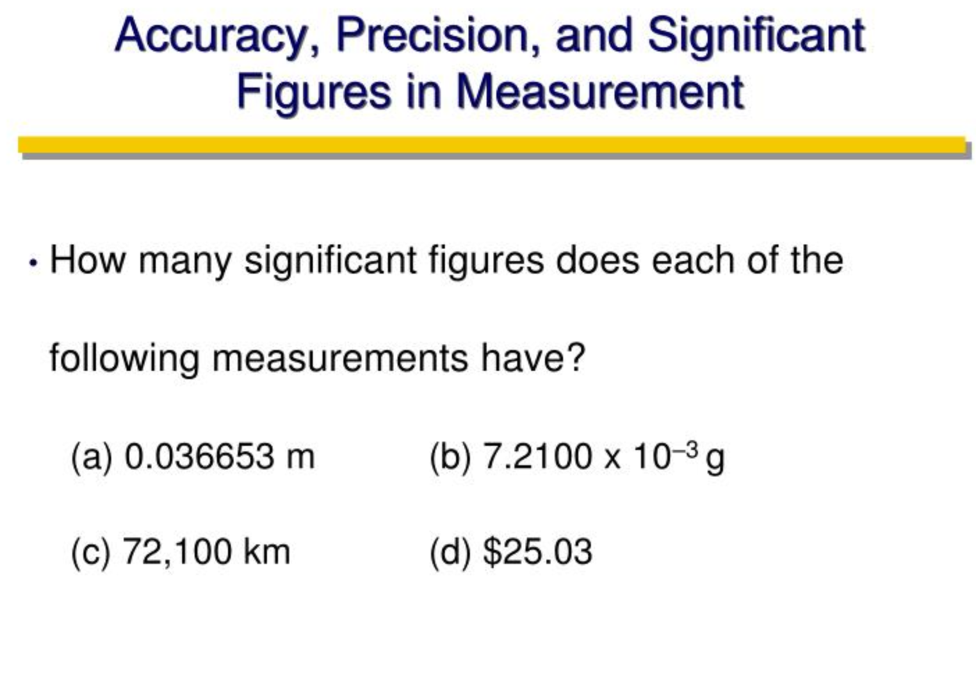

Slide 19
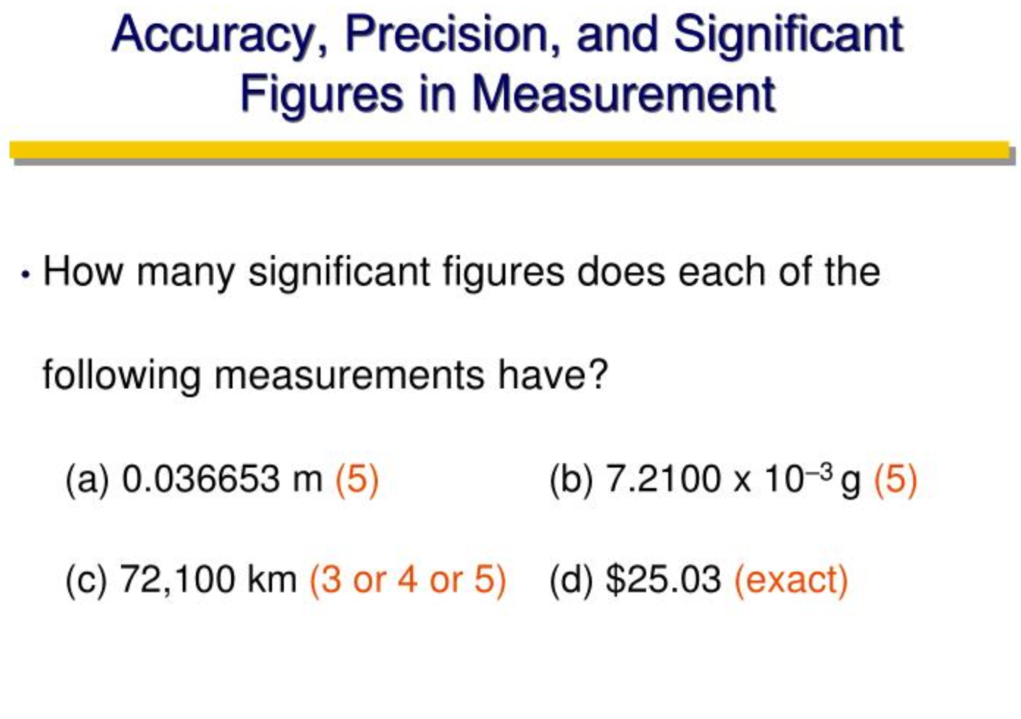

Slide 20
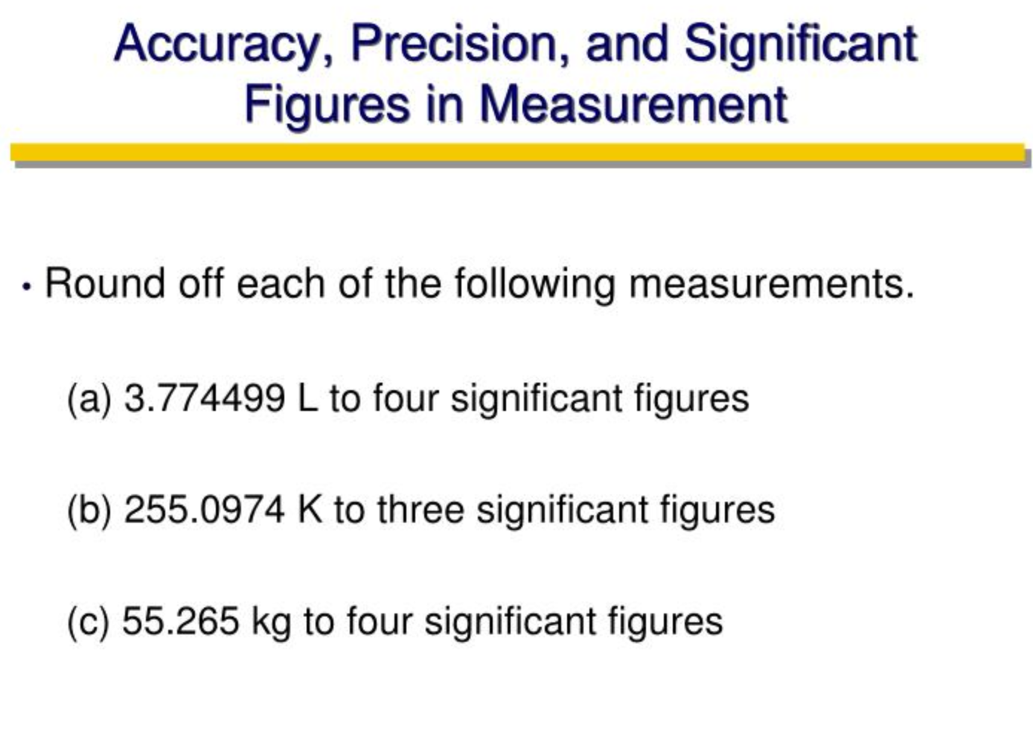

Slide 21
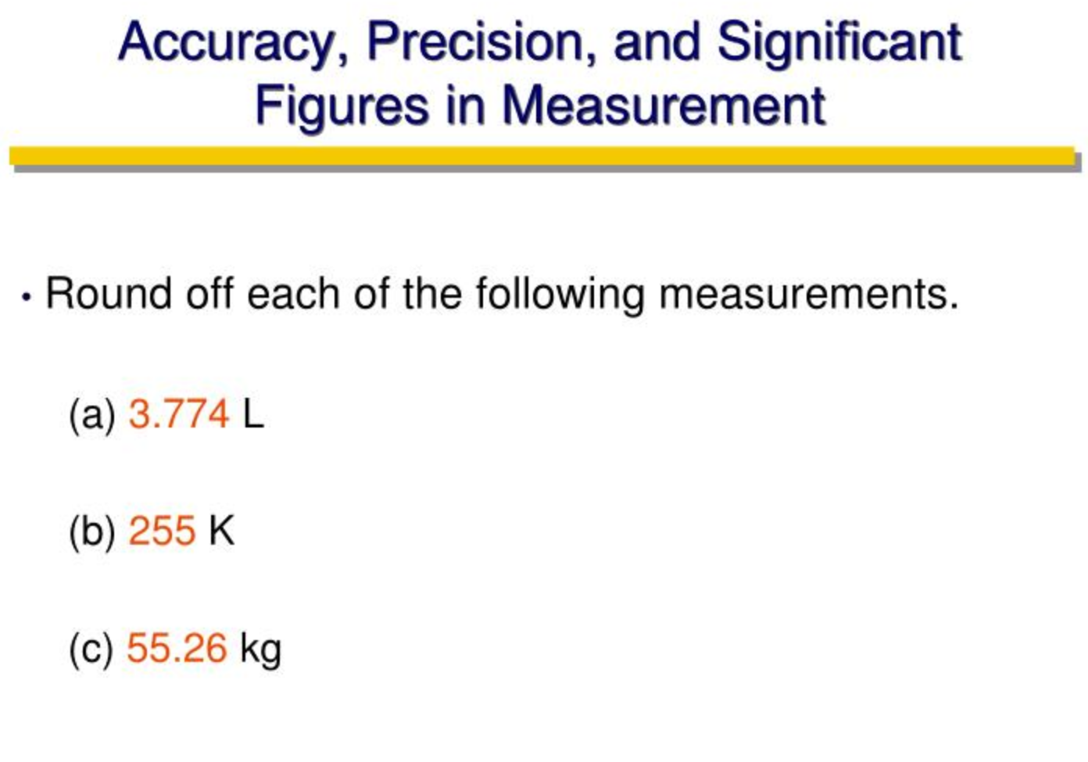

Slide 22
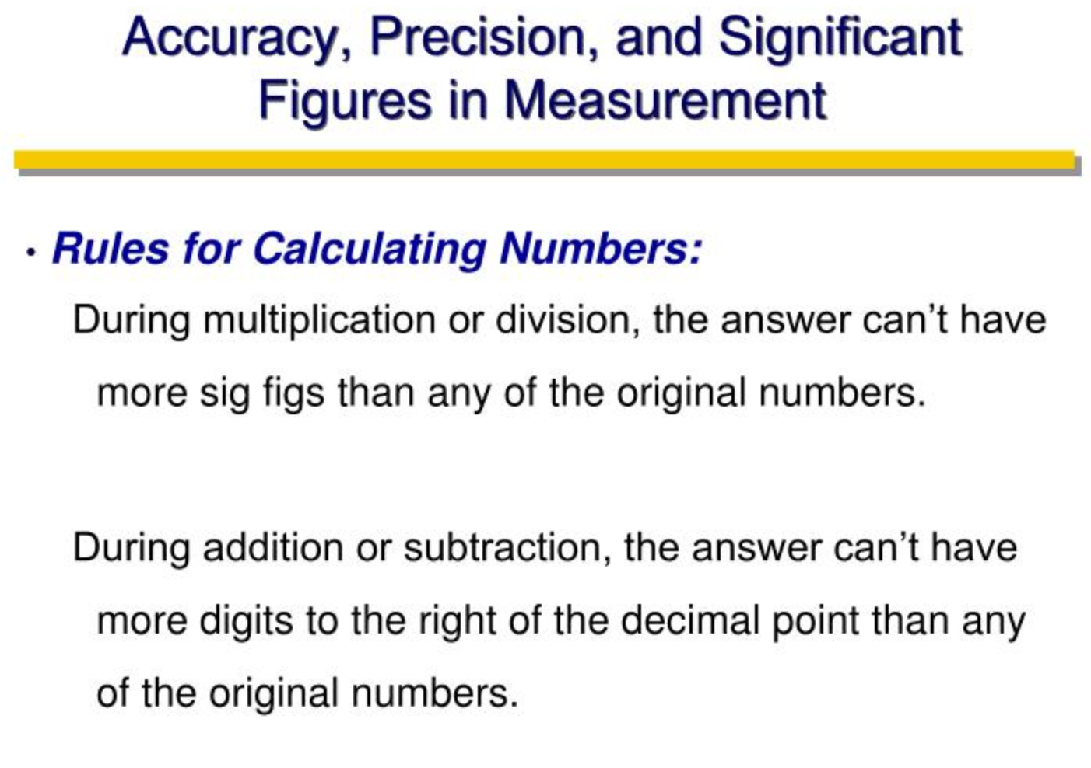

Slide 23
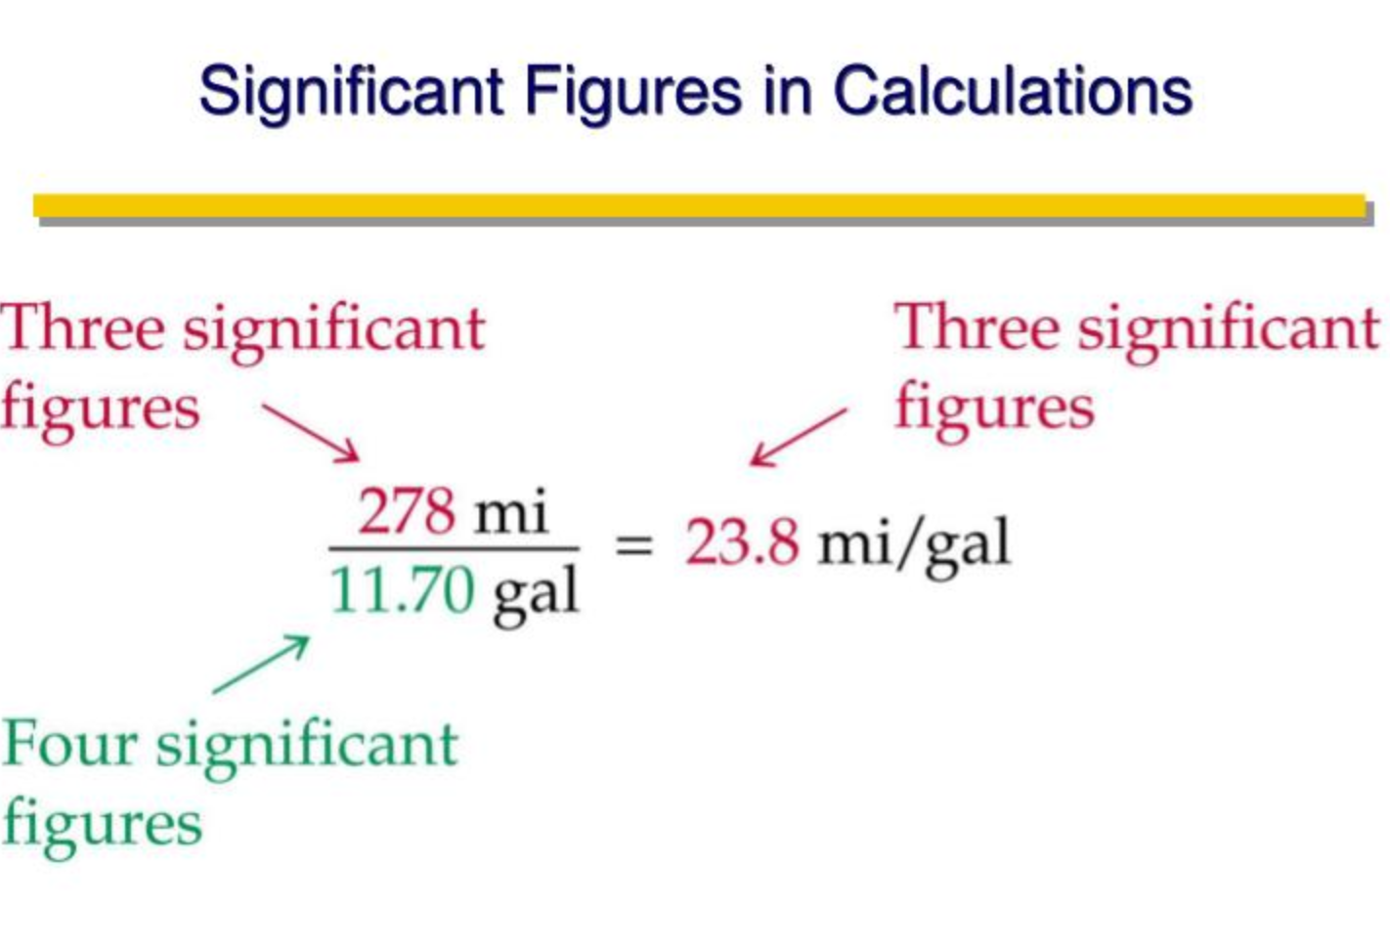

Slide 24
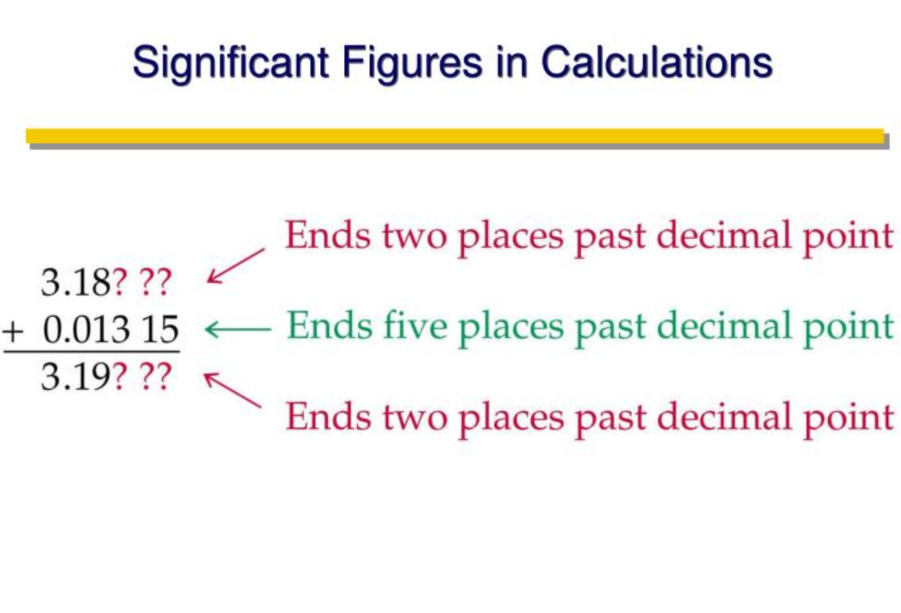

Slide 25
Errors in Measurement
Feature | Random Error | Systematic Error
Predictability | Unpredictable | Predictable
Effect on Data | Affects precision | Affects accuracy
Correction Method | Reduced by repetition & averaging | Requires calibration or redesign
Examples | Human reaction time, environmental changes | Miscalibrated instruments, zero error, parallax error

